Slide 1
Sustainable Development Goals

Slide 2
Introduction
The 2030 Agenda for Sustainable Development, adopted by all United Nations Member States in 2015, provides a shared blueprint for peace and prosperity for people and the planet, now and into the future. At its heart are the 17 Sustainable Development Goals (SDGs), which are an urgent call for action by all countries - developed and developing - in a global partnership.
The SDGs cover social and economic development issues including poverty, hunger, health, education, global warming, gender equality, water, sanitation, energy, urbanization, environment and social justice

Slide 3
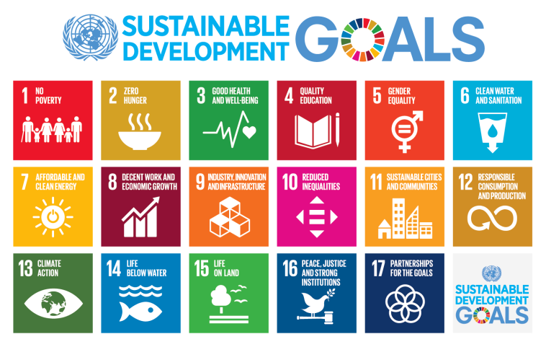

Slide 4
Goal 1: No poverty
"End poverty in all its forms everywhere.”
Extreme poverty has been cut by more than half since 1990. Still, more than 1 in 5 people live on less than the target figure. That target may not be adequate for human subsistence, however. Some suggest it may be necessary to raise the poverty line. Poverty is more than the lack of income or resources. People live in poverty if they lack basic services such as healthcare, security, and education. They also experience hunger, social discrimination, and exclusion from decision-making processes.

Slide 5
Goal 2: Zero hunger
"End hunger, achieve food security and improved nutrition, and promote sustainable agriculture"
Goal 2 states that by 2030 we should end hunger and all forms of malnutrition. This would be accomplished by doubling agricultural productivity and incomes of small-scale food producers (especially women and indigenous peoples), by ensuring sustainable food production systems, and by progressively improving land and soil quality. Agriculture is the single largest employer in the world, providing livelihoods for 40% of the global population. It is the largest source of income for poor rural households

Slide 6
Goal 3: Good health and well-being for people
"Ensure healthy lives and promote well-being for all at all ages.“
Significant strides have been made in increasing life expectancy and reducing some of the common killers associated with child and maternal mortality. Between 2000 and 2016, the worldwide under-five mortality rate decreased by 47 percent. Still, the number of children dying under age five is extremely high. SDG Goal 3 aims to reduce under-five mortality to at least as low as 25 per 1,000 live births. But if current trends continue, more than 60 countries will miss the SDG neonatal mortality target for 2030. About half of these countries would not reach the target even by 2050.

Slide 7
Goal 4: Quality education
"Ensure inclusive and equitable quality education and promote lifelong learning opportunities for all.“
Major progress has been made in access to education, specifically at the primary school level, for both boys and girls. Still, at least 22 million children in 43 countries will miss out on pre-primary education unless the rate of progress doubles.

Slide 8
Goal 5: Gender equality
"Achieve gender equality and empower all women and girls."
According to the UN, "gender equality is not only a fundamental human right, but a necessary foundation for a peaceful, prosperous and sustainable world." Providing women and girls with equal access to education, health care, decent work, and representation in political and economic decision-making processes will nurture sustainable economies and benefit societies and humanity at large. A record 143 countries guaranteed equality between men and women in their constitutions as of 2014. However, another 52 had not taken this step. In many nations, gender discrimination is still woven into the fabric of legal systems and social norms.

Slide 9
Goal 6: Clean water and sanitation
"Ensure availability and sustainable management of water and sanitation for all.
The Sustainable Development Goal Number 6 (SDG6) has eight targets and 11 indicators that will be used to monitor progress toward the targets. Most are to be achieved by the year 2030. One is targeted for 2020. The first three targets relate to drinking water supply and sanitation. Worldwide, 6 out of 10 people lack safely managed sanitation services, and 3 out of 10 lack safely managed water services. Safe drinking water and hygienic toilets protect people from disease and enable societies to be more productive economically.

Slide 10
Goal 7: Affordable and clean energy
"Ensure access to affordable, reliable, sustainable and modern energy for all.“
Targets for 2030 include access to affordable and reliable energy while increasing the share of renewable energy in the global energy mix. This would involve improving energy efficiency and enhancing international cooperation to facilitate more open access to clean energy technology and more investment in clean energy infrastructure. Plans call for particular attention to infrastructure support for the least developed countries, small islands and land-locked developing countries.

Slide 11
Goal 8: Decent work and economic growth
"Promote sustained, inclusive and sustainable economic growth, full and productive employment and decent work for all.“
For the least developed countries, the economic target is to attain at least a 7 percent annual growth in gross domestic product (GDP). Achieving higher productivity will require diversification and upgraded technology along with innovation, entrepreneurship, and the growth of small- and medium-sized enterprise. The target for 2020 is to reduce youth unemployment and operationalize a global strategy for youth employment.

Slide 12
Goal 9: Industry, Innovation, and Infrastructure
"Build resilient infrastructure, promote inclusive and sustainable industrialization, and foster innovation"
Manufacturing is a major source of employment. In 2016, the least developed countries had less "manufacturing value added per capita”. The manufacturing of high products contributes 80 percent to total manufacturing output in industrialized economies but barely 10 percent in the least developed countries.

Slide 13
Goal 10: Reducing inequalities
"Reduce income inequality within and among countries."
One target is to reduce the cost of exporting goods from least developed countries. "Duty-free treatment" has expanded. As of 2015, 65 percent of products coming from the least developed countries were duty-free, as compared to 41 percent in 2005.

Slide 14
Goal 11: Sustainable cities and communities
"Make cities and human settlements inclusive, safe, resilient, and sustainable."
The target for 2030 is to ensure access to safe and affordable housing. The indicator named to measure progress toward this target is the proportion of urban population living in slums or informal settlements.

Slide 15
Goal 12: Responsible consumption and production
"Ensure sustainable consumption and production patterns.”
The targets of Goal 12 include using eco-friendly production methods and reducing the amount of waste. By 2030, national recycling rates should increase, as measured in tons of material recycled. Further, companies should adopt sustainable practices and publish sustainability reports.

Slide 16
Goal 13: Climate action
"Take urgent action to combat climate change and its impacts by regulating emissions and promoting developments in renewable energy."
In May 2015, a report concluded that tackling climate change will only be possible if the SDGs are met. Further, economic development and climate change are inextricably linked, particularly around poverty, gender equality, and energy. The UN encourages the public sector to take initiative in this effort to minimize negative impacts on the environment.

Slide 17
Goal 14: Life below water
"Conserve and sustainably use the oceans, seas and marine resources for sustainable development”
Improving the oceans contributes to poverty reduction, as it gives low-income families a source of income and healthy food. Keeping beaches and ocean water clean in less developed countries can attract tourism, as stated in Goal 8, and reduce poverty by providing more employment. The targets include preventing and reducing marine pollution and acidification, protecting marine and coastal ecosystems, and regulating fishing. The targets also call for an increase in scientific knowledge of the oceans.

Slide 18
Goal 15: Life on land
"Protect, restore and promote sustainable use of terrestrial ecosystems, sustainably manage forests, combat desertification, and halt and reverse land degradation and halt biodiversity loss.”
This goal articulates targets for preserving biodiversity of forest, desert, and mountain eco-systems, as a percentage of total land mass. Achieving a "land degradation-neutral world" can be reached by restoring degraded forests and land lost to drought and flood. Goal 15 calls for more attention to preventing invasion of introduced species and more protection of endangered species.

Slide 19
Goal 16: Peace, justice and strong institutions
"Promote peaceful and inclusive societies for sustainable development, provide access to justice for all and build effective, accountable and inclusive institutions at all levels."
Reducing violent crime is clear global goal. The International Community values peace and justice and calls for stronger judicial systems that will enforce laws and work toward a more peaceful and just society.

Slide 20
Goal 17: Partnerships for the goals
"Strengthen the means of implementation and revitalize the global partnership for sustainable development.”
Increasing international cooperation is seen as vital to achieving each of the 16 previous goals. Goal 17 is included to assure that countries and organizations cooperate instead of compete. Developing multi-stakeholder partnerships to share knowledge, expertise, technology, and financial support is seen as critical to overall success of the SDGs. Public-private partnerships that involve civil societies are specifically mentioned.

